Slide 1

What Statistics Can (and Can’t) Tell Us About Sports
Michael J. Lopez
Skidmore College

Slide 2
Experiment
A basketball player makes 50% of his shots.
Write down 10 random 1s and 0s to represent a sequence player shots

Slide 3
Experiment
Now take a coin and toss it 10 times.
Write down 1 to represent tails, 0 to represent tails.

Slide 4
Experiment
Now take a coin and toss it 10 times.
Write down 1 to represent tails, 0 to represent tails.
Compare the two sets of 10 numbers:
What is the total number of 1s?
What is the longest streak of 1s or 0s?

Slide 5
Experiment
How does this apply to sports?
For most of what we learn, we need to compare it to what would have happened due to chance.
Corollary: If we know what happens due to chance alone, we can use that to compare players, teams, strategies

Slide 6
Experiment
How does this apply to sports?
Understanding randomness:
Can players get hot?
Should you fire a coach?
How do players age?
What’s the best in-game decision?
What policies should the league adopt?
Which player to sign?

Slide 7
Outline
Introduction
Examples
What’s left to do/what can’t be done

Slide 8
What is sports statistics?
Statistics: science of learning from data
Statistics in sports: science of learning from data in sports

Slide 9
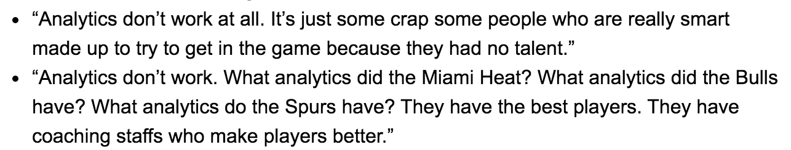
What they’re saying
Charles Barkley

Slide 10
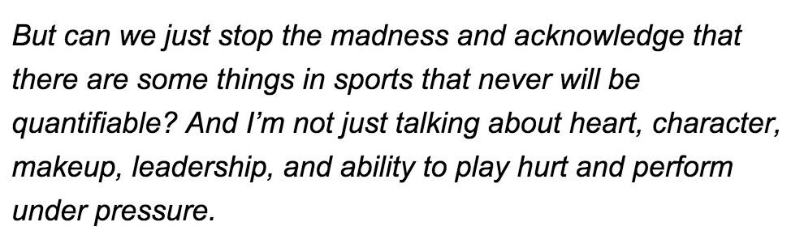
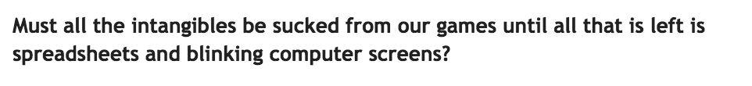
What they’re saying
Dan Shaughnessy

Slide 11
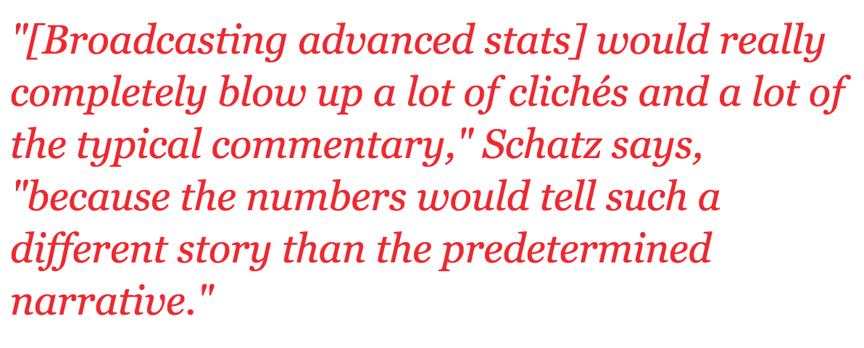
What they’re saying
Aaron Schatz (Football Outsiders)

Slide 12
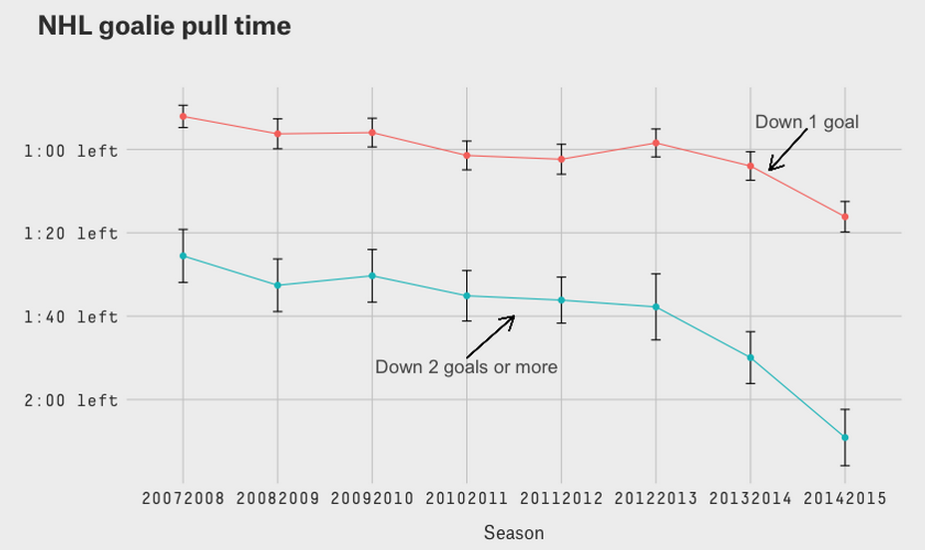
So what can stats tell us?
How teams behave
-Bill Simmons

Slide 13
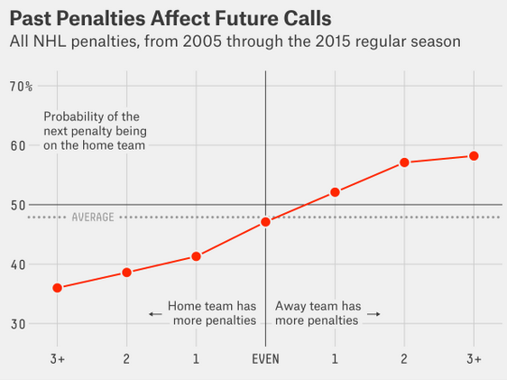
So what can stats tell us?
How referees behave
-Bill Simmons

Slide 14
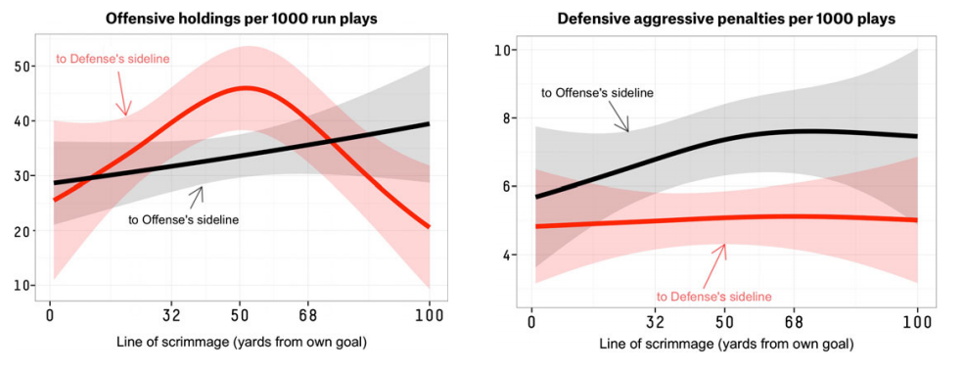
So what can stats tell us?
How referees behave

Slide 15
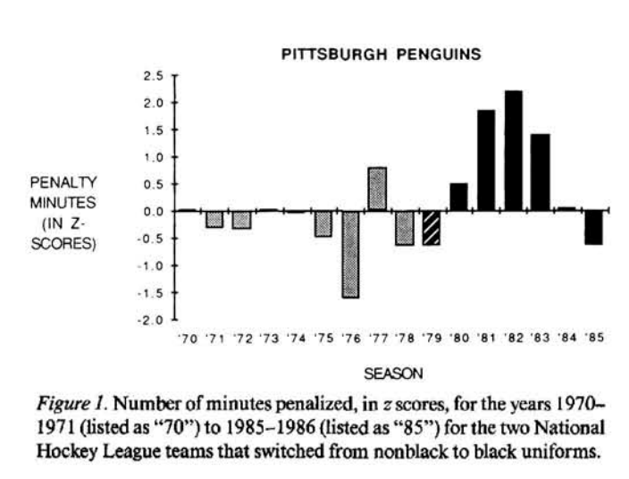
So what can stats tell us?
How referees behave

Slide 16
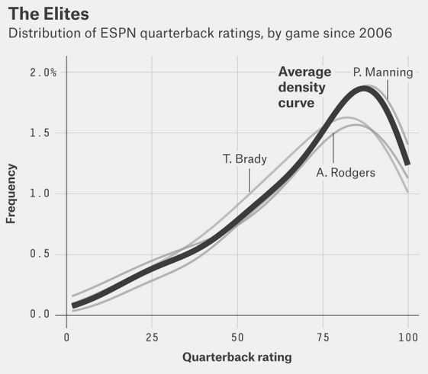
So what can stats tell us?
Which players are the best
-Bill Simmons

Slide 17
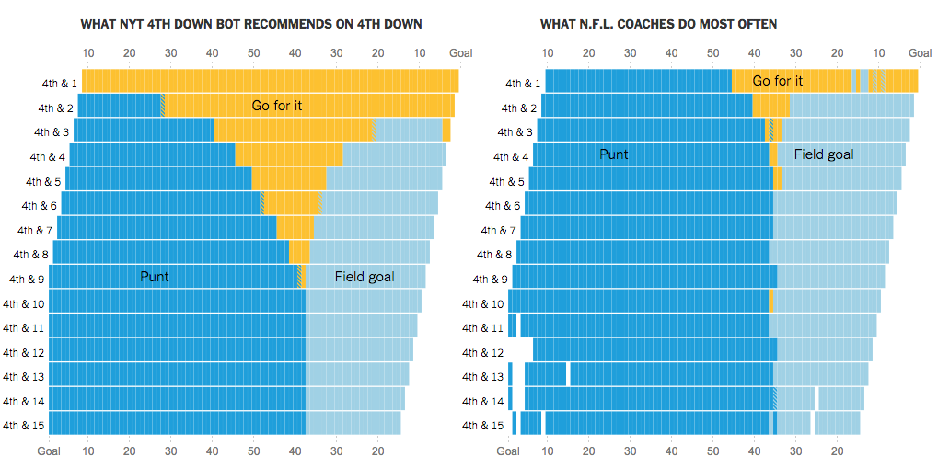
So what can stats tell us?
Game strategy
-Bill Simmons

Slide 18
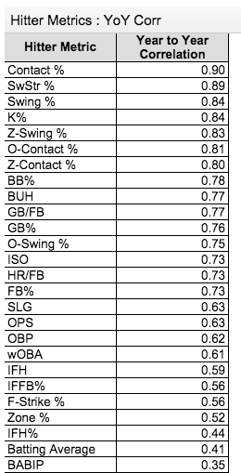
So what can stats tell us?
Player prediction

Slide 19
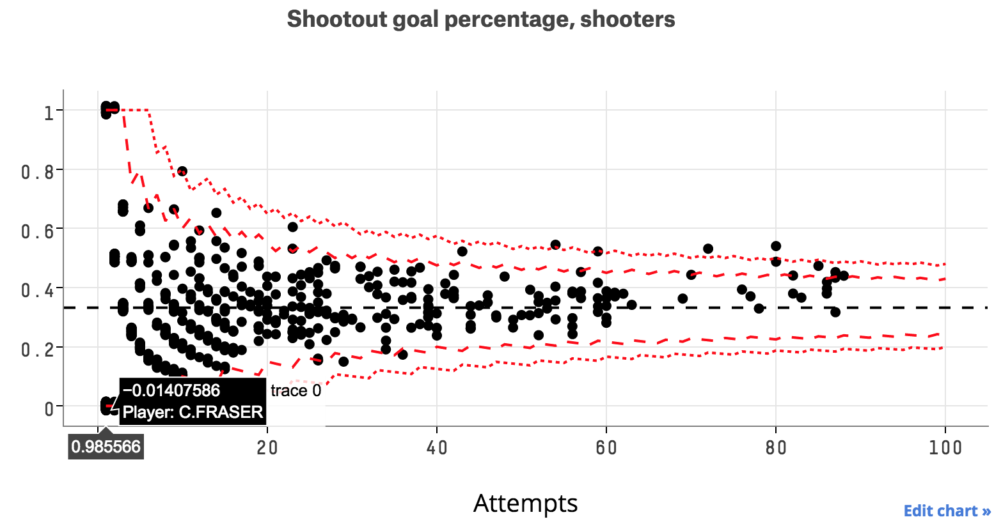
So what can stats tell us?
Player performance (link)

Slide 20
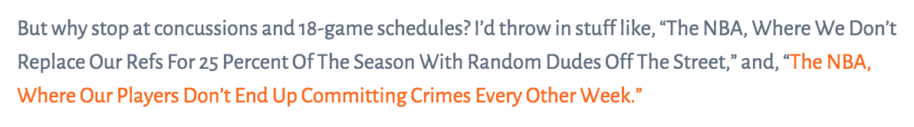
So what can stats tell us?
Social issues
-Bill Simmons
-Bill Simmons
NBA arrest rate: 5.1% of players
NFL arrest rate: 2.1% of players

Slide 21
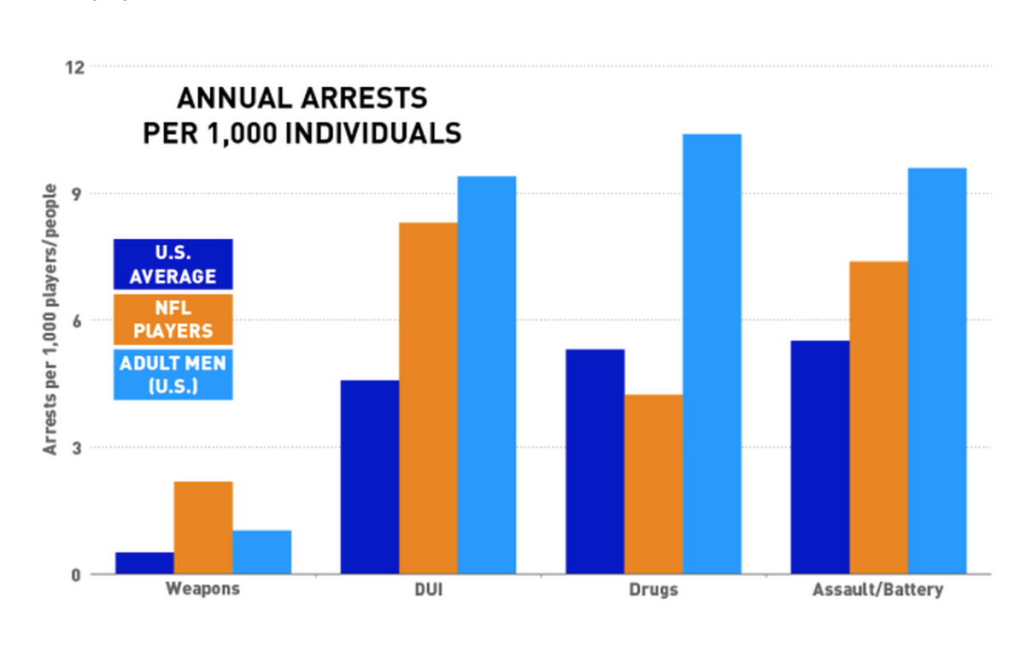
What stats can tell us

Slide 22
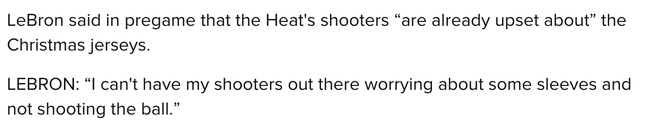
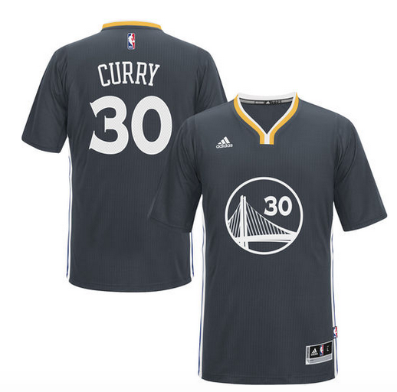
What stats can tell us
Popular narratives

Slide 23
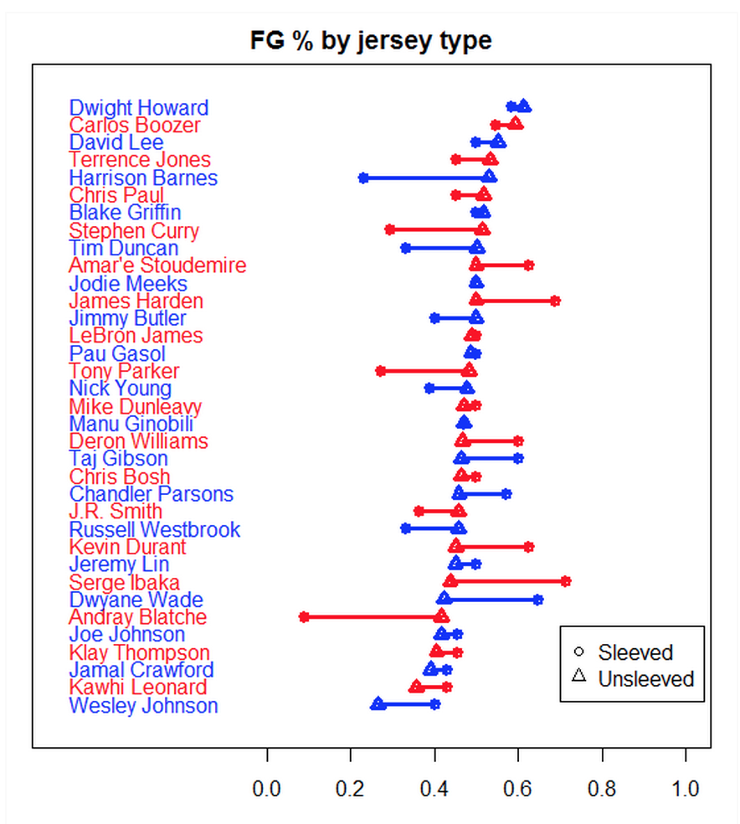
What stats can tell us
Popular narratives

Slide 24
Looking back

Slide 25
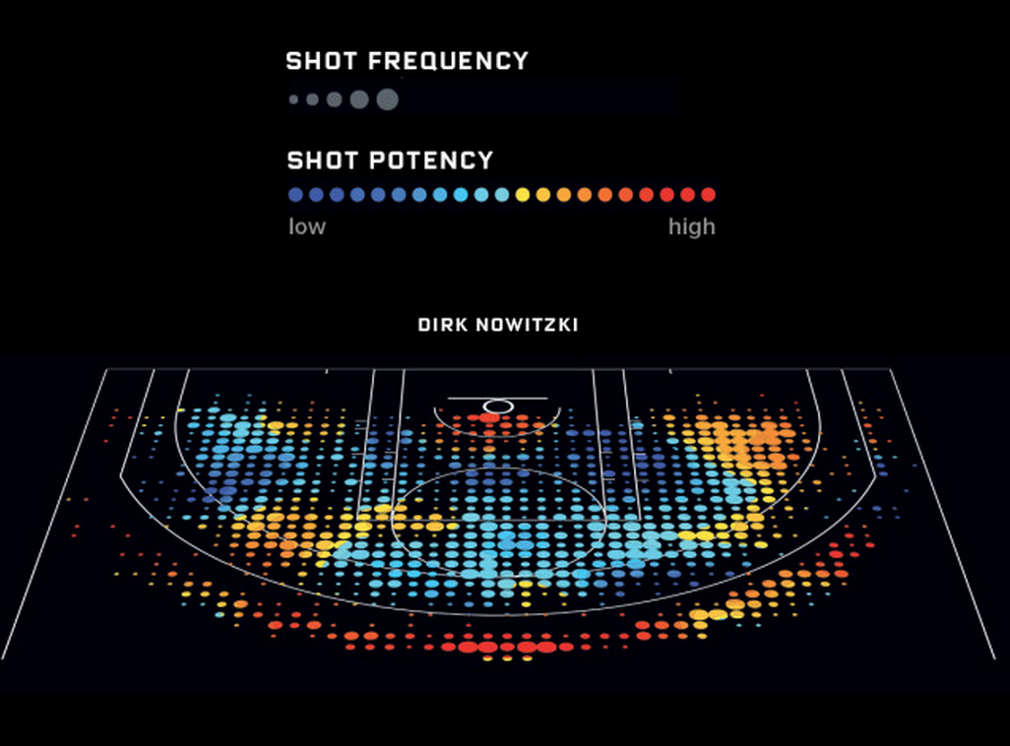
Looking forward

Slide 26
Looking forward
What hasn’t been answered is what hasn’t been measured
-Injuries
-Spatial associations
-Intangibles
-Strategy implementation
What can’t be answered is what can’t be measured
-Player performance in unknown environment
-What else?

Slide 27
Skills & tools
- Available data
- Coding
- Domain knowledge
- Communication
- Comparison group

Slide 28
What we get

